Slide 1



PROJECT EXHIBITION - I
Course Code : DSN2098
Final-Review
Team No. - 36
Supervisor : Dr.Nirmala E
Reviewer: Dr.Chandan Kumar Behera
Reviewer : Dr.Santosh Kumar Sahoo

Slide 2

TEAM MEMBERS
Dhairya Gothi - 23BCE10225
Rishita Mehta - 23BCE10235
Riddhi Mhadgut - 23BCE10110
Shreya Dubey - 23BCE10516
Mrityunjay Singh - 23BCE10008

Slide 3



SAMVIDHAN - PATH
"Bringing the Constitution Closer to Every Citizen"
Welcome to SamvidhanPath, your gateway to understanding the Indian Constitution!
Our platform is dedicated to enhancing constitutional literacy among citizens of all ages. We simplify the complex language of the Constitution, making it accessible and engaging through interactive quizzes, multimedia resources, and gamified learning experiences.
Empower yourself with knowledge about your fundamental rights and duties, and join us in fostering a more informed and responsible citizenry. Explore, learn, and engage with SamvidhanPath today!

Slide 4

















Existing Work With Limitations
Low Constitutional Literacy : Many citizens, including youth, lack awareness of their fundamental rights, duties, and the significance of the Constitution of India.
Complex Legal Language : The Constitution is written in complex legal terms, making it difficult for the average citizen to comprehend its content and principles.
Limited Accessibility: There are limited accessible resources that present the Constitution in a simplified, user-friendly format for diverse educational background
Lack of Engagement: Traditional methods of teaching constitutional values are often unengaging, failing to spark interest or foster deeper understanding among citizens.
Inclusivity Issues: Existing educational platforms don't effectively cater to non-English speakers or those with varying literacy levels, limiting broad access to constitutional education.

Slide 5



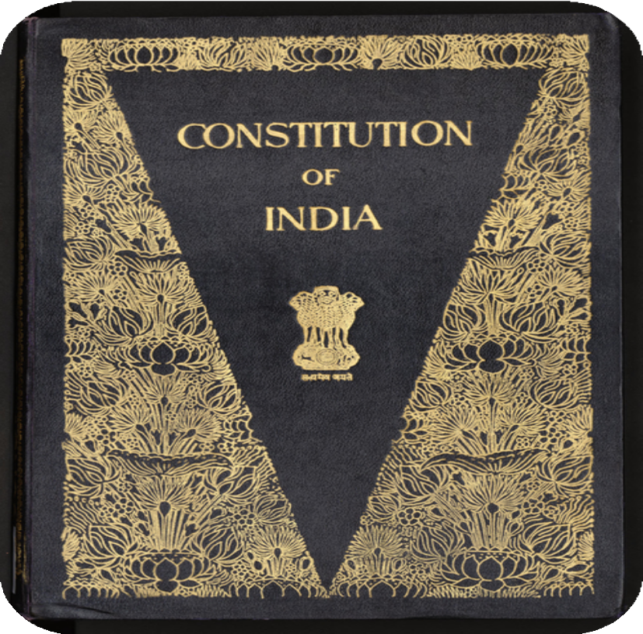

Proposed work & methodology
Samvidhan Path
"Bringing the Constitution Closer to Every Citizen"
Promoting Constitutional Awareness: Samvidhan Path enhances understanding of the Constitution of India, making its provisions clear and relatable for all citizens.
Accessible and User-Friendly:
Designed with an intuitive interface, Samvidhan Path ensures easy navigation, allowing users of all ages to access information effortlessly.
Engaging Learning Experience:
The platform utilizes gamification techniques to create interactive activities that make learning about constitutional rights and duties enjoyable.
Multimedia and Community Engagement: By incorporating various multimedia resources and fostering community discussions, the platform encourages active participation and collective learning about constitutional values.

Slide 6







CHALLENGES
User Interface (UI/UX) : Designing an intuitive interface that is easy to navigate for all user demographics.
Real-Time Updates: Implementing a system to provide timely updates on constitutional changes and legal amendments.
Testing and Feedback: Running beta tests with diverse user groups to gather feedback and improve the platform.
Localization:
Developing multilingual support for various regional languages.
Content Creation: Breaking down complex articles and case laws into simplified summaries.
Mobile Compatibility: Ensuring the platform is optimized for mobile use.

Slide 7






Novelty of the Project
Interactive Discussion forum
A space for discussions on constitutional issues, moderated to ensure quality.
User-Driven Constitution Explorer
Allow users to explore the Indian Constitution in an interactive way
Case Study Repository
Include landmark Supreme Court judgments with simplified explanations and context for each.
Advanced features
Simplified Educational Resources
Website provides complete information about the Indian Constitution for all the age groups
Features like enhanced accessibilty, Text Highlighting, User Modes & Text to Speech in multiple languages are available.

Slide 8











Real Time Usage
Empowered Citizens:
Increased awareness of rights leads to better decision-making and protection from exploitation.
Reduced Legal Issues:
Understanding constitutional provisions minimizes misunderstandings and frivolous legal cases.
Improved Governance:
Informed citizens can hold authorities
accountable and
participate meaningfully in policy- making.
Strengthened Democracy:
Informed citizens are v i tal for a
thriving
democracy.

Slide 9







Real Time Usage
Builds a More Informed and Engaged Citizenry:
Contributes to a stronger, more equitable, and just society.
Increased Constitutional Literacy :
Empowers citizens with knowledge of their rights and responsibilities.
Enhanced Social Cohesion:
Promotes active participation in democratic processes.
Fosters Civic Engagement:
Shared knowledge fosters a sense of unity and understanding among citizens.

Slide 10










Hardware and Software Requirement
Hardware Requirements:
Server/Hosting:
Cloud servers (e.g., AWS EC2, Microsoft Azure, or Google Cloud) for scalable hosting
Hardware Requirement
Client Devices:
Desktops, laptops, tablets, and smartphones (Android & iOS) Internet connection (broadband or mobile data)
Storage:
Cloud storage (e.g., AWS S3, Google Cloud Storage) for large content (eBooks, PDFs)
Relational or NoSQL Database (e.g., AWS RDS, MongoDB Atlas)

Slide 11

















Hardware and Software Requirement
Frontend:
Software
React.js (for dynamic, single-page app UI) Redux (for state management)
Next.js (for server-side rendering and SEO optimization) TailwindCSS (for utility-first CSS styling)
Backend:
Requirement
Node.js with Express.js (for server-side logic and API handling) MongoDB Atlas (for cloud-based NoSQL database)
Redis (for session management and caching) Development Tools:
Docker (for containerization and environment consistency) GitHub Actions (for CI/CD pipeline management)
Jest & Mocha (for unit and integration testing)

Slide 12
Overall System Architecture
SAMVIDHAN - PATH

Slide 13

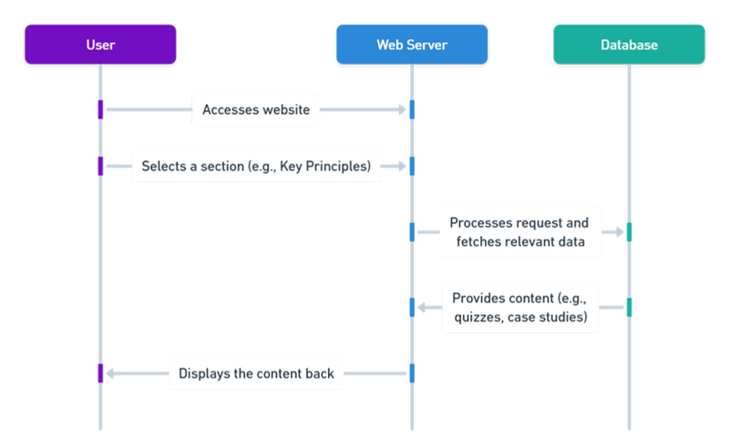
Sequence Diagram

Slide 14






Literature Review and Research
The Samvidhaan Path website serves as a digital platform to promote constitutional awareness and legal literacy.
The literature highlights several key aspects relevant to its development:
Role of Constitutional Awareness: Educating citizens about their rights and duties is critical for strengthening democracy. Digital tools, like Samvidhaan Path, play a vital role in bridging knowledge gaps and empowering individuals.
Existing Platforms: Comparisons with global and Indian initiatives (e.g., U.S. Constitution Annotated, Lawctopus) show that Samvidhaan Path stands out with its focus on interactive features, gamification, and accessibility in regional languages.
Addressing Legal Literacy Barriers: Complex legal jargon and a lack of access to resources are major obstacles. Samvidhaan Path tackles these by offering simplified content, regional language support, and audio-visual aids.
Impact of Gamification and Engagement: Research shows that gamified tools, such as quizzes and leaderboards, improve learning and retention, making Samvidhaan Path’s design both innovative and effective.
Challenges: Long-term success depends on inclusivity, user retention, and regular content updates to maintain engagement across diverse audiences.

Slide 15
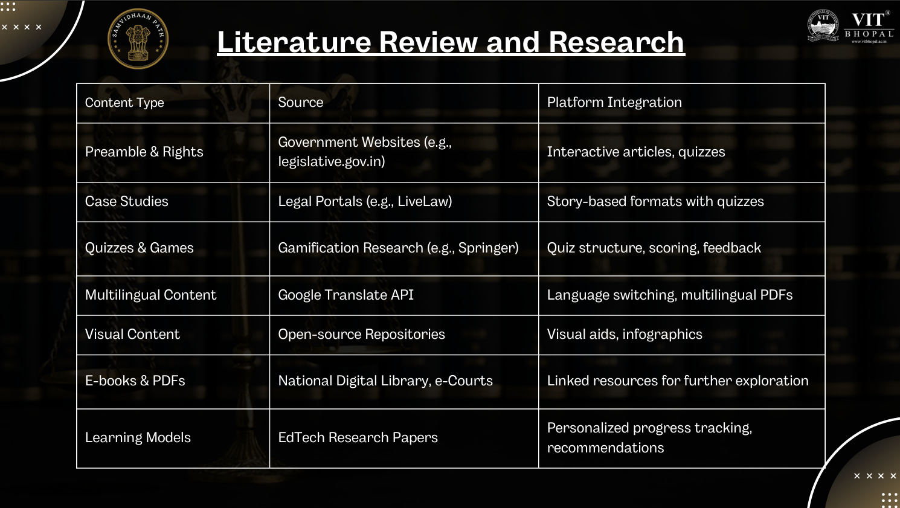
Content Type
Preamble & Rights Case Studies
Quizzes & Games
Multilingual Content Visual Content
E-books & PDFs
Learning Models
Source
Government Websites (e.g., legislative.gov.in)
Legal Portals (e.g., LiveLaw)
Gamification Research (e.g., Springer) Google Translate API
Open-source Repositories
National Digital Library, e-Courts
EdTech Research Papers
Platform Integration
Interactive articles, quizzes Story-based formats with quizzes Quiz structure, scoring, feedback
Language switching, multilingual PDFs Visual aids, infographics
Linked resources for further exploration
Personalized progress tracking, recommendations

Slide 16
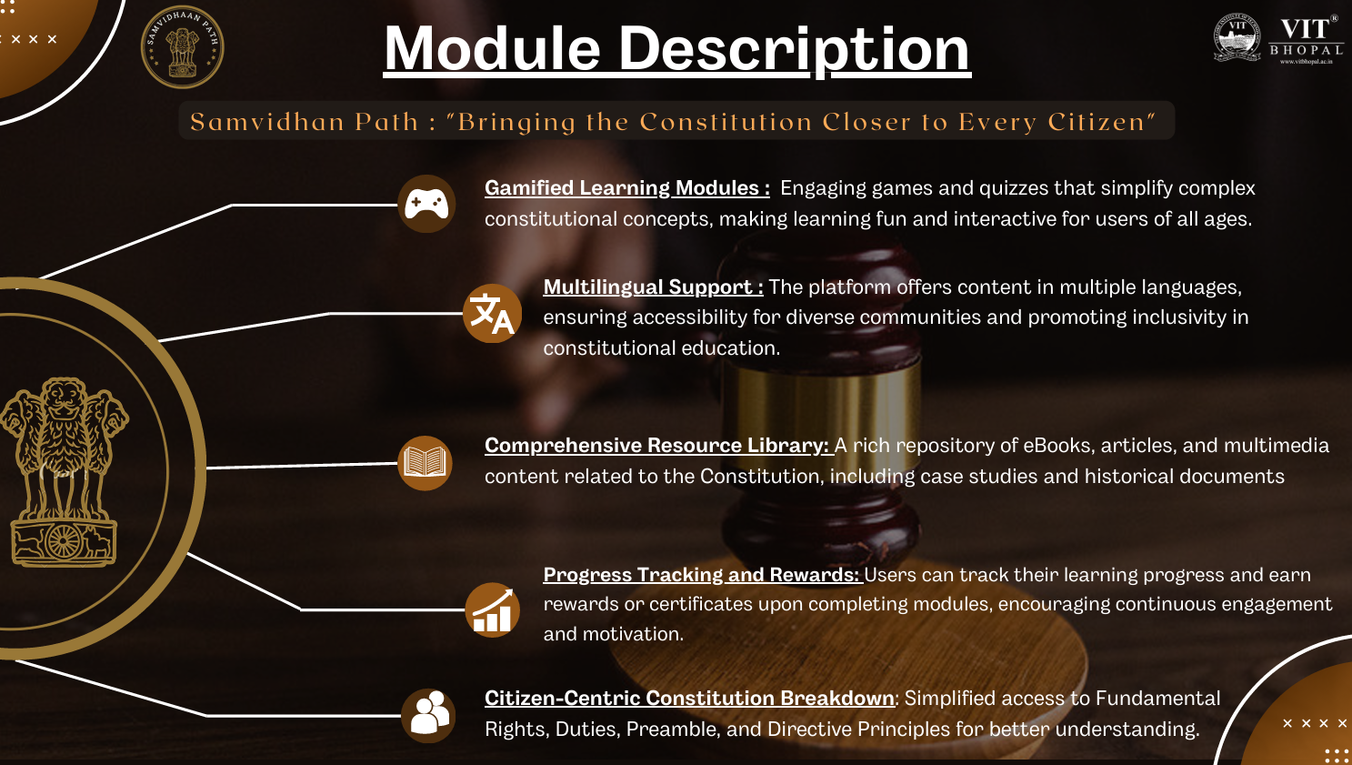

Slide 17









Module Work Flow
START YOUR JOURNEY
TRACE CONSTITUTIONAL HISTORY
JOIN THE
CONVERSATION
EXPLORE THE CONSTITUTION
TEST YOUR KNOWLEDGE
ACCESS IN YOUR LANGUAGE
LEARN ABOUT
LANDMARK JUDGMENTS
KNOW YOUR RIGHTS
TRACK AND
STAY UPDATED

Slide 18
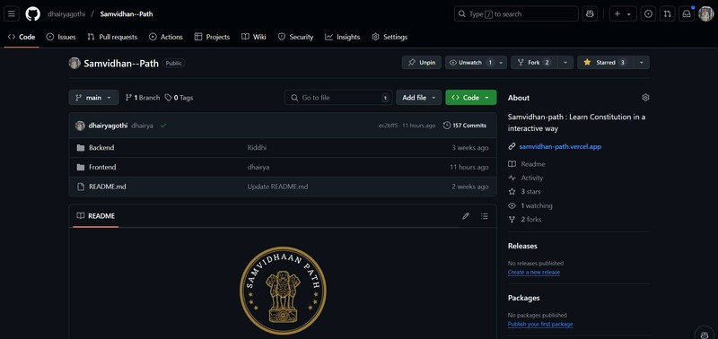
Implementation And Coding
GitHub Repository :- https://github.com/dhairyagothi/Samvidhan--Path

Slide 19
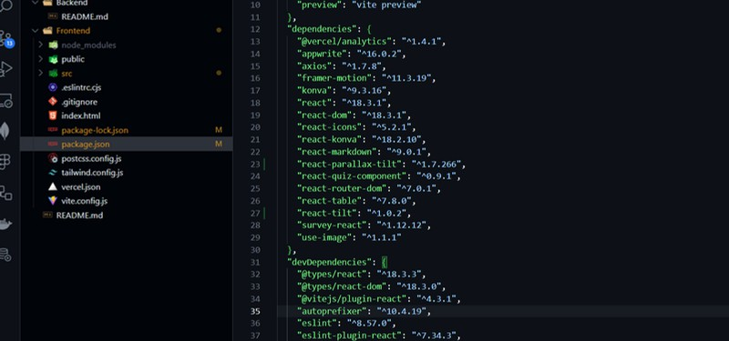
Implementation And Coding
TECH-STACK DEPENDENCIES

Slide 20


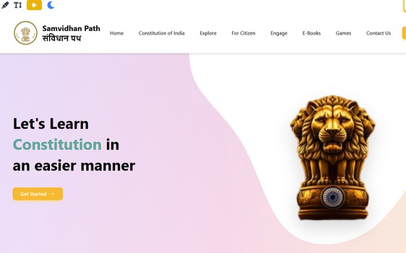
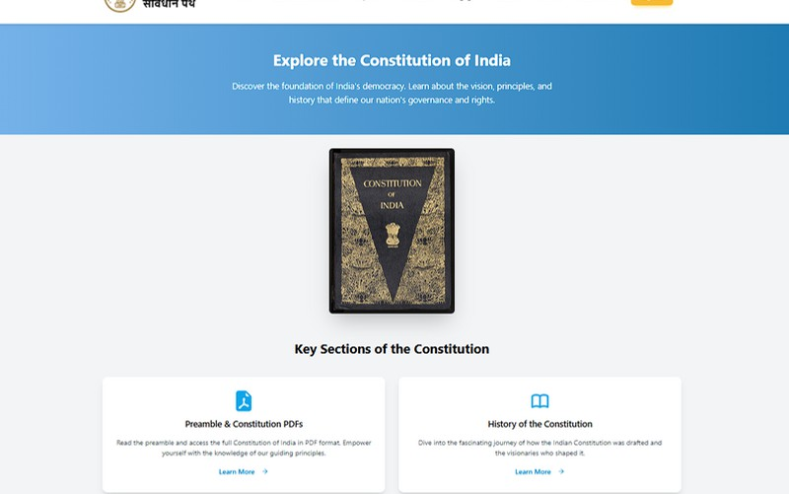

Snap Shot
SAMVIDHAN - PATH
Prototype :- https://samvidhan-path.vercel.app/

Slide 21
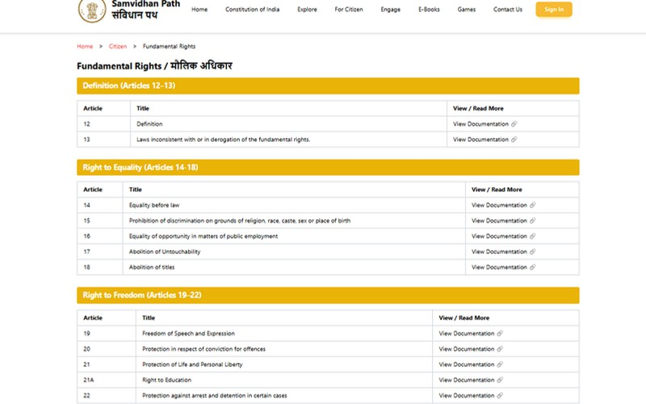
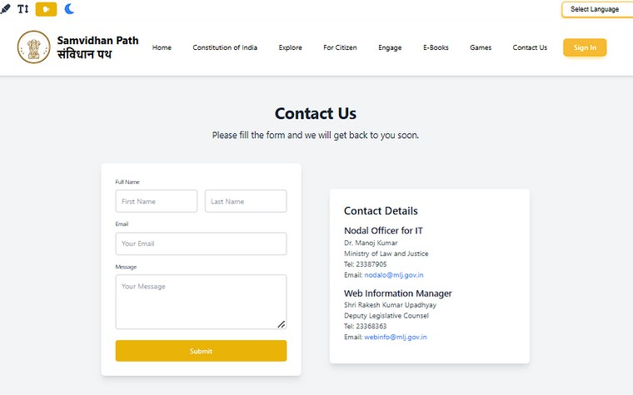
Snap Shot
SAMVIDHAN - PATH
Prototype :- https://samvidhan-path.vercel.app/

Slide 22

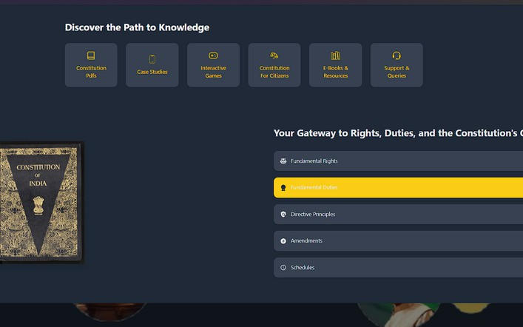
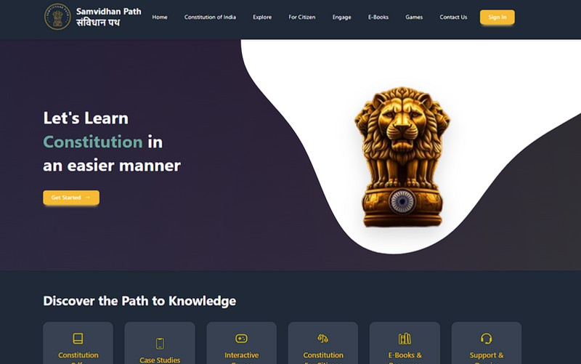
Snap Shot
SAMVIDHAN - PATH
Prototype :- https://samvidhan-path.vercel.app/

Slide 23
Future Scope & Discussion
Expansion to Multiple Languages: Expand to various Indian languages, promoting inclusivity across diverse linguistic groups.
Advanced Gamification: Implement quizzes, simulations, and games to make learning interactive and engaging.
Data Analytics for Policy Makers: Provide insights into constitutional literacy, helping policymakers target educational initiatives efficiently
Partnership with Government and NGOs: Collaborate to expand reach, promote civic literacy, and implement awareness campaigns effectively.
AI-Powered Personalized Learning: Use AI to offer personalized learning paths and track user progress for better understanding.

Slide 24



RESULT
Enhanced Accessibility
User Engagement
Informative Modules
Practical Learning
Simplified constitutional content in regional languages and audio narration improved inclusivity.
Gamified elements like quizzes and leaderboards fostered active participation.
Constitution Explorer and Timeline of Amendments received positive feedback for clarity and ease of use.
Real-life examples in the "Know Your Rights" module made the
content relatable.

Slide 25

DISCUSSION
Community Interaction
Discussion forums and polls encouraged active dialogue on legal and constitutional issues.
Future Potential
Regular updates and expanded features will strengthen the platform’s impact and scalability.
Challenges
Sustaining user retention and reaching marginalized communities require continuous improvement.

Slide 26


SAMVIDHAN - PATH
Conclusion
Samvidhan Path will empower citizens by simplifying the Constitution, making it more accessible.
It will engage users through interactive, gamified learning experiences.
The platform will promote inclusivity by offering content in multiple languages.
It will provide citizens with a rich library of constitutional resources, including case studies and eBooks.
Samvidhan Path will foster community discussions, encouraging shared learning and deeper insights.

